Slide 1
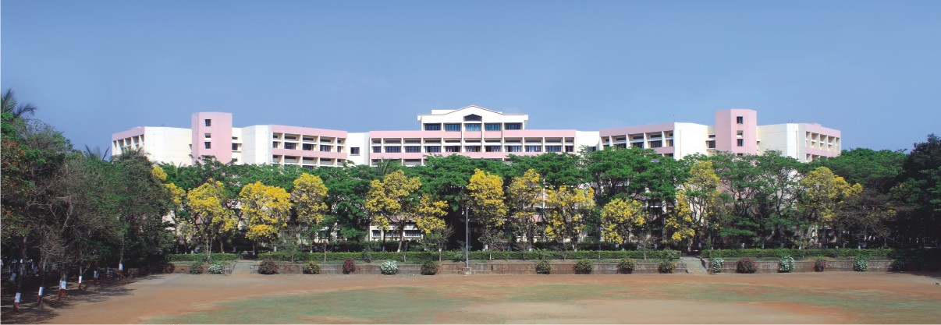

INTERNSHIP PRESENTATION
Presented by:
Ganesh Jahagirdar
TE_B_17
Submitted to:
Prof. N. D. Ghuse

Slide 2

CONTENTS
Internship Details
Certificate
Project Description
Data Set Overview
EDA
Data Preprocessing
Algorithm Used
Trained Model Output
Conclusion

Slide 3
TRAINING DETAILS
Start Date : 15 Dec 2024
End Date : 15 Jan 2024
Mode of Training : Online
Training Company : Compozent
Location : Mumbai

Slide 4
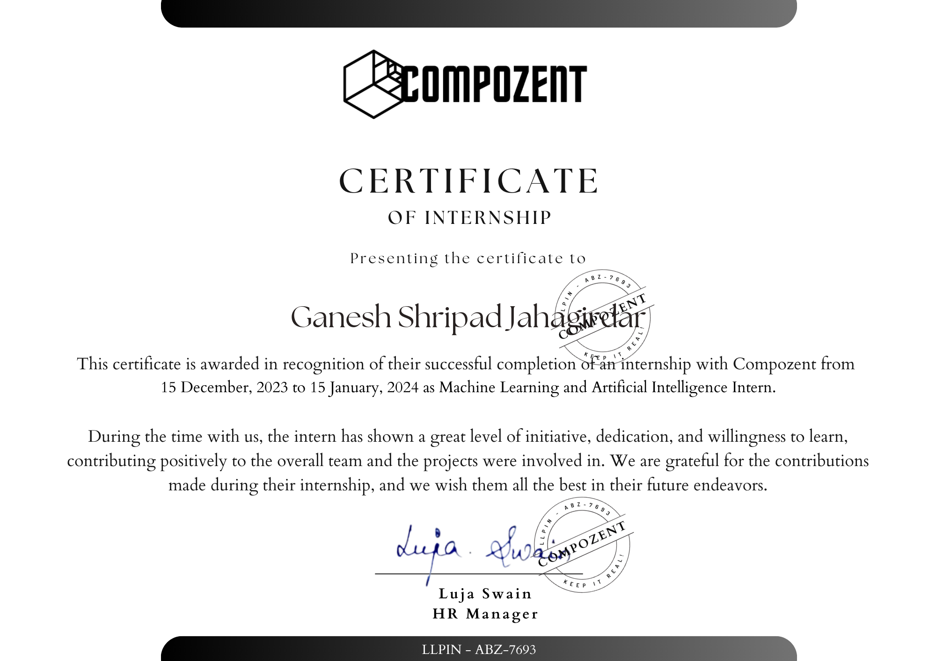
Certificate

Slide 5
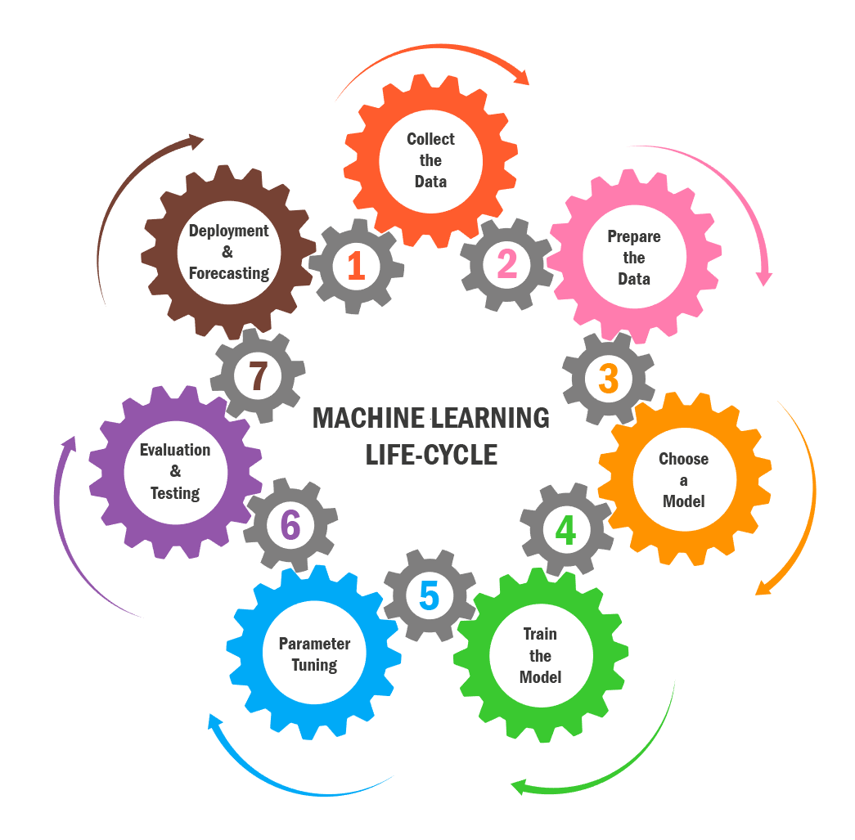
INTRODUCTION TO MACHINE LEARNING

Slide 6
PROJECT DESCRIPTION
1. Data cleaning
2. EDA
3. Text Preprocessing
4. Model building
5. Evaluation
6. Improvement
7. Website
8. Deploy

Slide 7
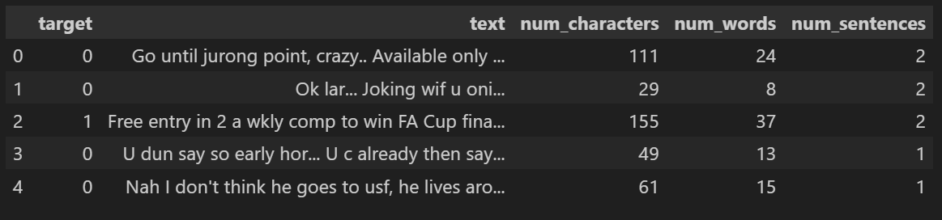
Data Set Overview
Total (row, column) = (5169,5)
Target
Text
Num_Charactors
Num_Words
Num_Sentances

Slide 8
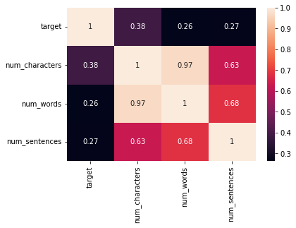
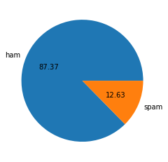
Exploratory Data Analysis:

Slide 9
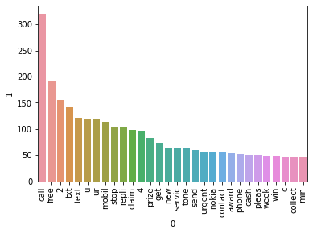
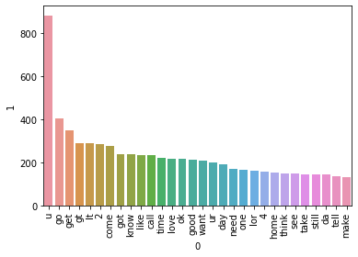
Data Preprocessing:

Slide 10
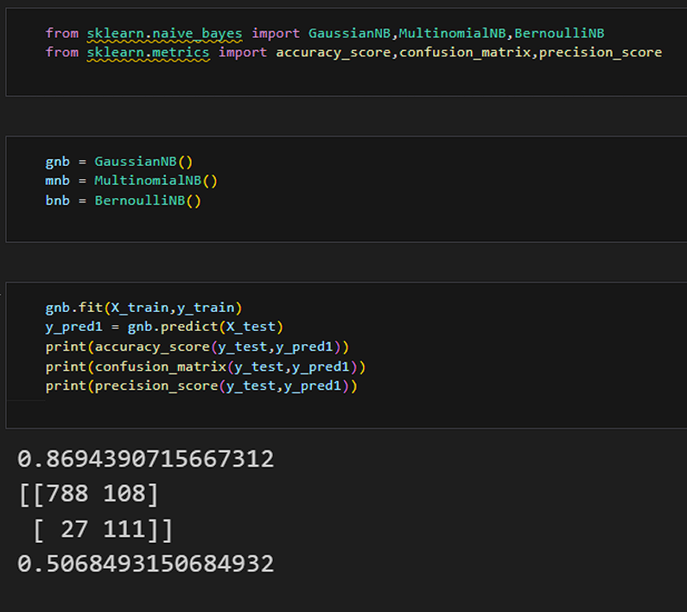
ALGORITHMS USED
Naïve Bytes algorithm:
Work well with Small to Medium-sized Dataset
Effective in Non – Linear separable
Versatility in kernel Selection
Effective in High-Dimensional Spaces
Accuracy (%) = 90-100%

Slide 11
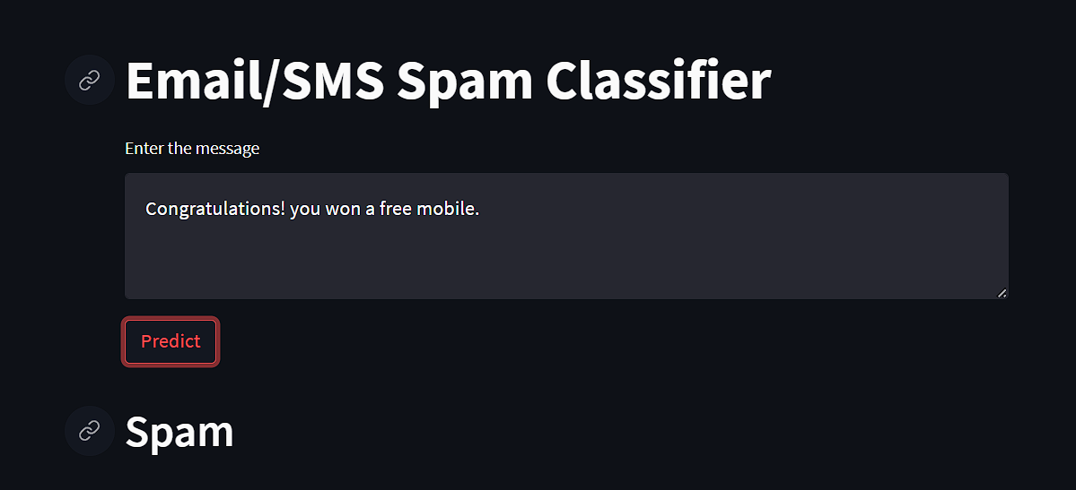
TRAINED MODEL OUTPUTS

Slide 12
CONCLUSION
An Email/SMS spam detection system serves as a pivotal tool in safeguarding users against the incessant onslaught of unsolicited and potentially malicious content. The project, focusing on the efficacy of machine learning algorithms in this domain, yielded compelling results with the Random Forest classifier. Trained on meticulously pre-processed and feature extracted data, the classifier demonstrated exceptional accuracy, precision, recall, and F1 score, surpassing alternative models.

Slide 13
THANK YOU !!
Name of Student: Ganesh Shripad Jahagirdar
Email: ganeshjahagidar1697@gamil.com
Department of Artificial Intelligence and Data Science.
K. K. Wagh Institute of Engineering Education & Research, Nashik

